Slide 1
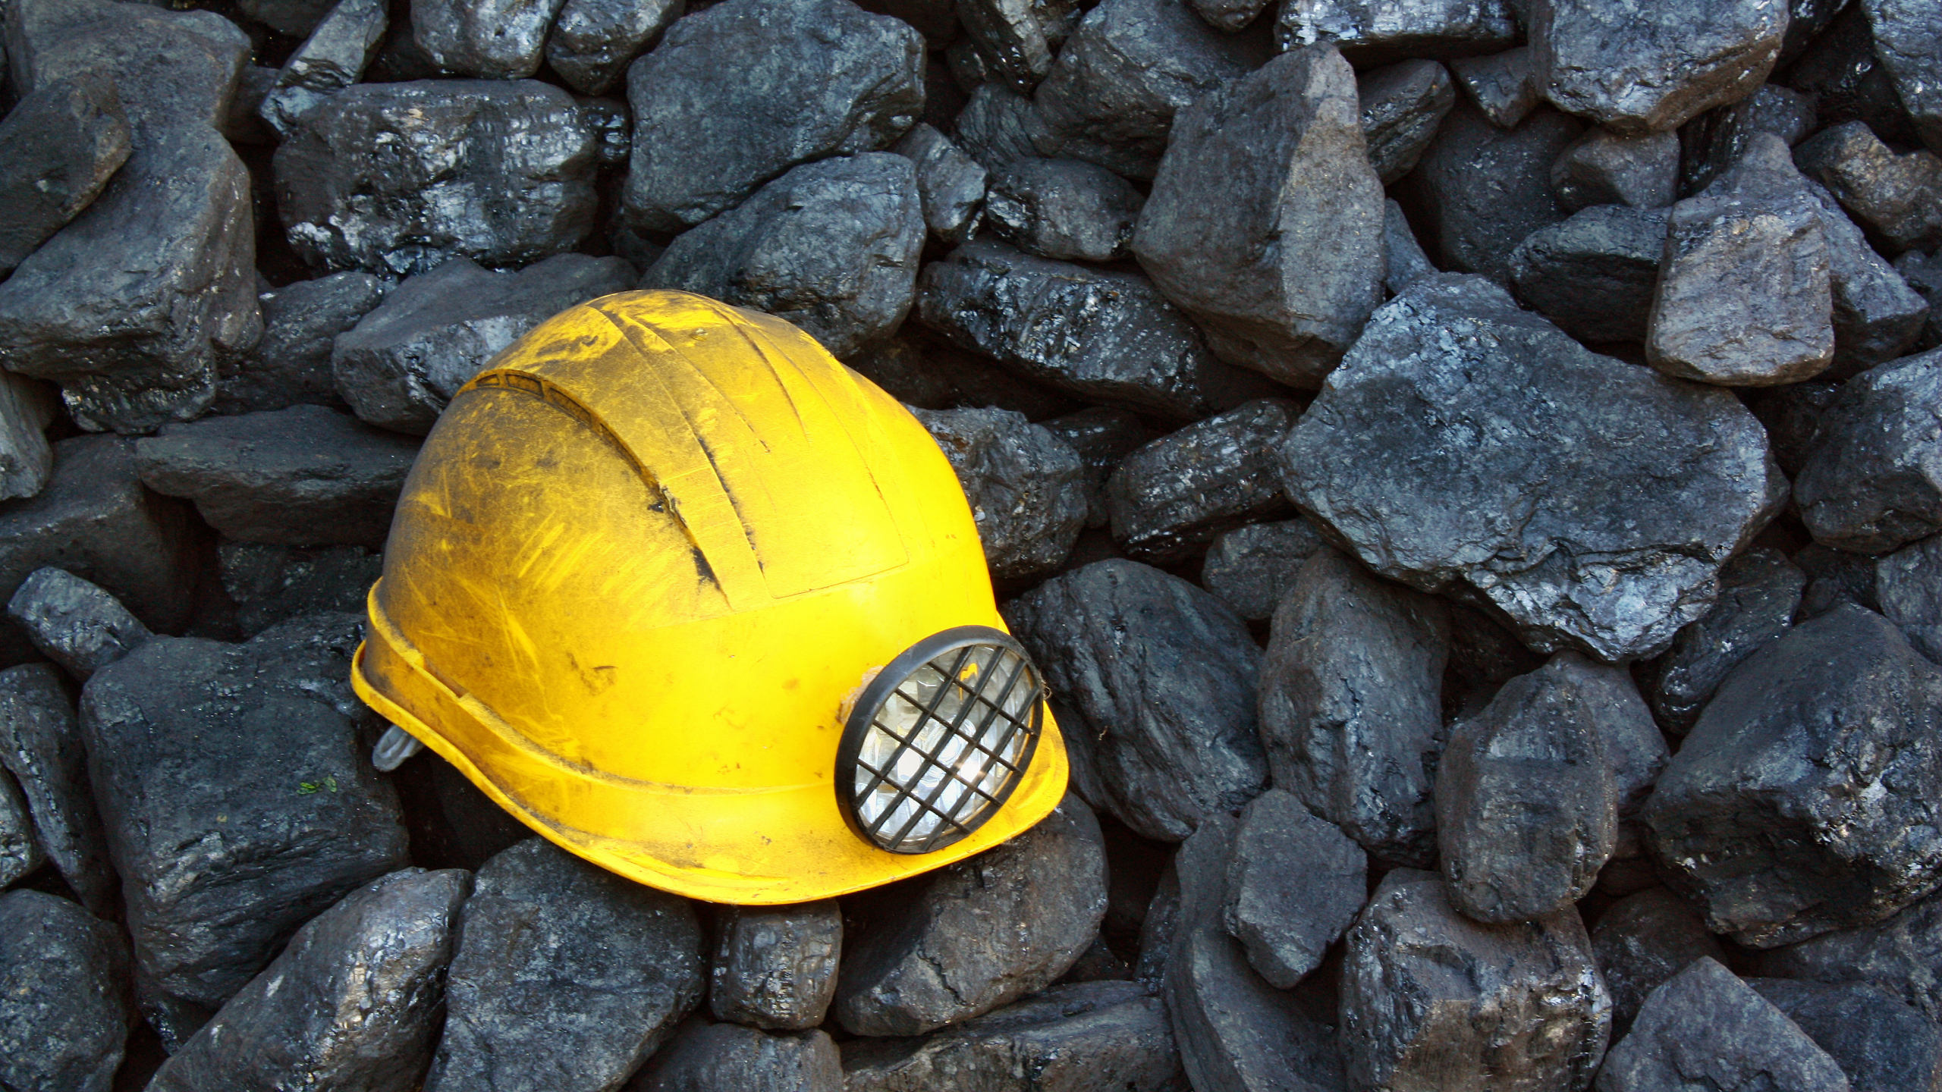
NOT A HELMET A Coal Mine Safety Standard
Hemant Suresh - 2019102016
Adithya Sunil - 2019102005
Vaibhav Bhushan – 2019112019
Astitva Ranjan - 2019112025

Slide 2
Project Motivation
For an industry that contributes to over a quarter of the global total primary energy consumption annually, coal mining has remained one of the most dangerous fields of work with almost no innovation in technology for centuries.
We aim to improve the lives of these labourers, especially in Third World Countries, with a cheap yet effective system, that combats these precarious situations with a quick response system that monitors conditions and alerts a central console as well as all labourers in the mines about any situation including but not limited to the release of dangerous gasses, tunnel collapses, extreme temperatures and humidity.
Additionally, upon detection of any of these hazards, a ventilation system is activated for the miners’ safety

Slide 3
Project Use-Case
We use Temperature, Humidity, Sound and Gas sensors for measuring various levels that covers most safety parameters.
It provides a feasible, low cost, low maintenance, easy to implement, easy to repair safety system. The sensors continuously detect parameters for any possible risks and transmits the data to the Thingspeak channel and central monitoring system through NodeMCU. Thus data from all the helmets can be monitored and stored at a single location.
In case of any anomaly, (i.e. If any sensor value exceeds a given threshold value) the corresponding LEDs on the helmet are switched on, alerting the person wearing it. The NodeMCU alerts the central system through the Thingspeak channel.
The push-button enables the worker to manually trigger the alarm in case of any emergencies.

Slide 4
Applications
This system can be modified using different types of gas sensors to be used in other kinds of mines.
We can expand the use of these systems beyond mines, and they can be used as general safety measures for firefighters, construction workers, hazardous waste engineers, traffic police and various other professions dealing with dangerous work environments.
Within mines, these arrangements can also be used along with existing safety measures like ventilation systems that can be remotely controlled by data from the sensors. If required, the exhaust motors can increase or decrease their speed according to data fed to the Thingspeak.
Additionally, the helmet will make it easier to locate the person wearing it in case of cave system collapses or other situations where miners are trapped underground.

Slide 5
Hardware and Components
NodeMCU – The Primary Microcontroller to transmit information between helmets and a central database.
DHT11 Sensor – Standard sensor used to detect Temperature and Humidity in the mines.
MQ-2 Sensor – Standard gas sensor used to detect the presence and intensity of dangerous gasses in the environment.
CZN-15E Sound Sensor – To detect loud explosions that could potentially be catastrophic.
Push Button – Acts as a manual Alarm trigger switch that labourers cab use when they detect danger.
LEDs - Multiple LEDs can be used in the system for various indications: LEDs turn on in case of any hazard, else they remain off.

Slide 6
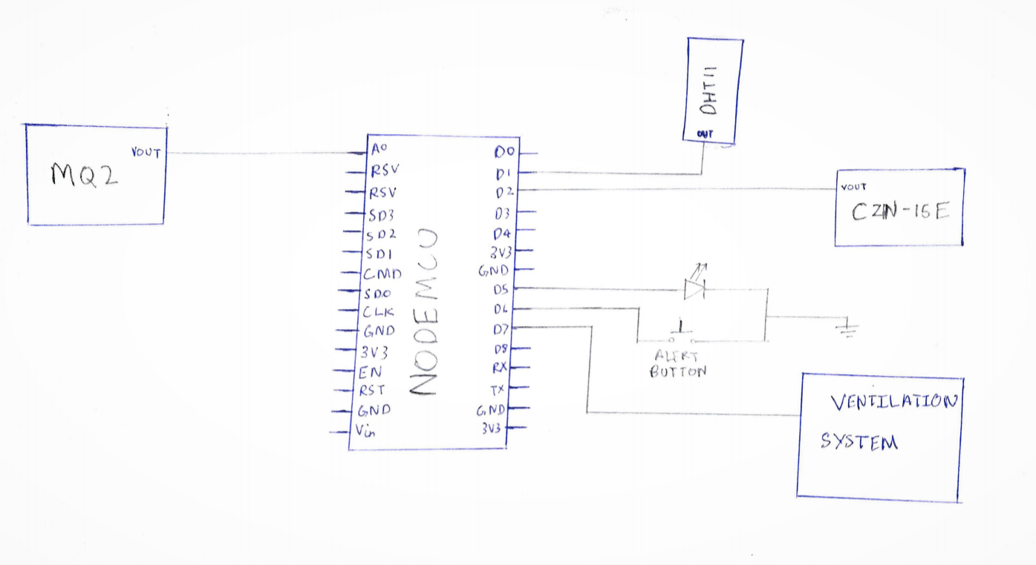
Circuit Diagram

Slide 7
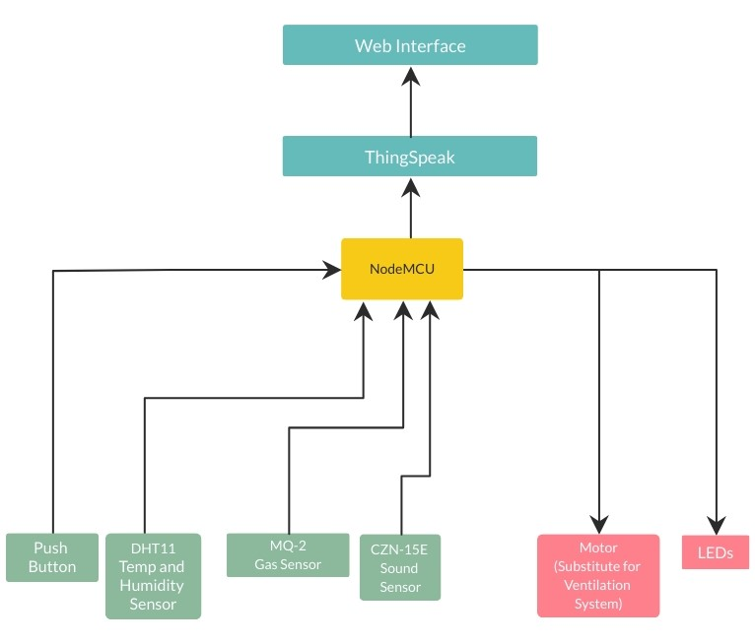
Data Flow Pipeline

Slide 8
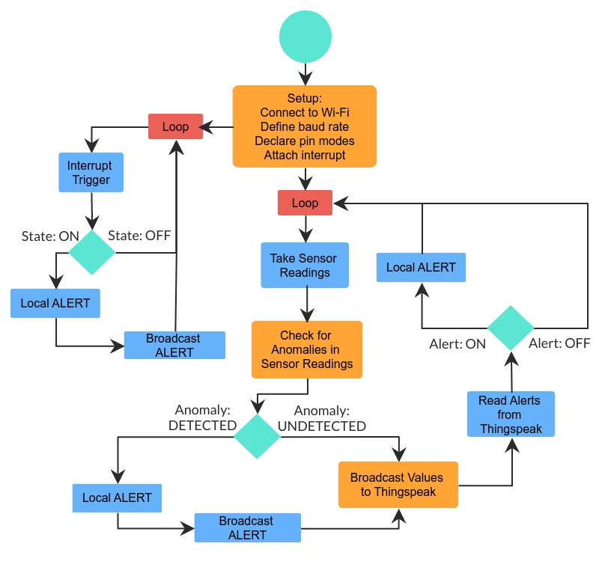
Code Flow Diagram (Full Code Attatched with PPT)

Slide 9
THANK YOU
STAY SAFE AND HAPPY MINING!

